Slide 1
Name : sanket mohan chaudhari mis : 111903085 batch : s5 div : 1 Dsa lab Project topic : grep command in Unix/Linux
grep stands for globally search for regular expression and print out
The grep filter searches a file for a particular pattern of characters, and displays all lines that contain that pattern

Slide 2
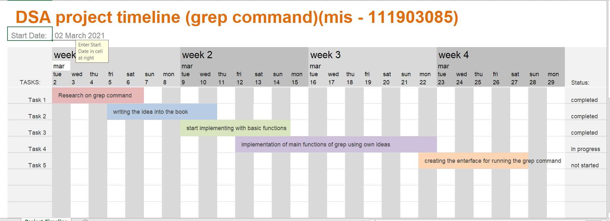
Project timeline

Slide 3

Functions that has to be implemented : 1. Case insensitive search (-i). 2. Displaying the count of number of matches(-c). 3. Display the file names that matches the pattern (-l). 4. Checking for the whole words in a file and displaying the lines(-w). 5. Displaying only the matched pattern (-o). 6. Show line number while displaying the output(-n). 7. Inverting the pattern match(-v) . 8. Matching the lines that start with a string(^). 9. Matching the lines that end with a string($). 10. Print n specific lines from a file(-a).
S.no | Time Analysis
1 | O(n)
2 | O(n^2)
3 | O(n)
4 | O(n^2)
5 | O(n^2)
6 | O(n)
7 | O(n)
8 | O(n)
9 | O(n)
10 | O(n^2)

Slide 4
Implementation details :
Data structure : linked list and array
programming language : c
Idea :
using file handling , program will read text files line by line and each line of text file get store in dynamic array .
To access the contained of array , I created a linked list which had three field
One field is character pointer which is pointed to the dynamic array which stores the single line of file ( name as ‘line’)
second field is line number which stores the line number of current line
Third field is pointer to the next node
For performing the each functions of grep command I made the linked list global
To show the output of grep command like terminal. I used menu driven program

Slide 5
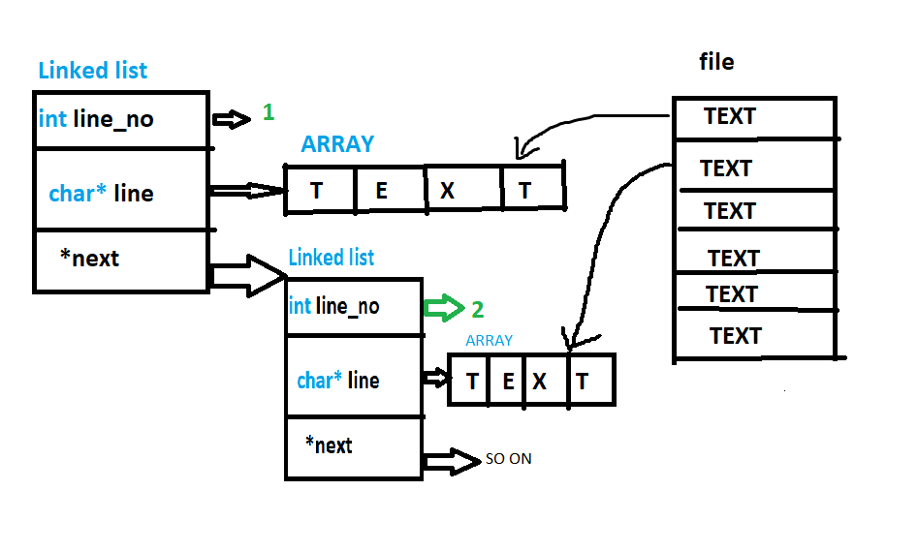
Graphical representaion

